Slide 1

Gotta Cache ‘Em All

Slide 2

Pokémon Hunters
Tiffany Harris
tiffanyharris711
Jessica Chester
jessches5
Bao Pham
baodphm
Tom Munson
TJM-TGC

Slide 3

The Evolution
Pokemon APIs
Python
SqlLite
Flask App
HTML
Javascript

Slide 4

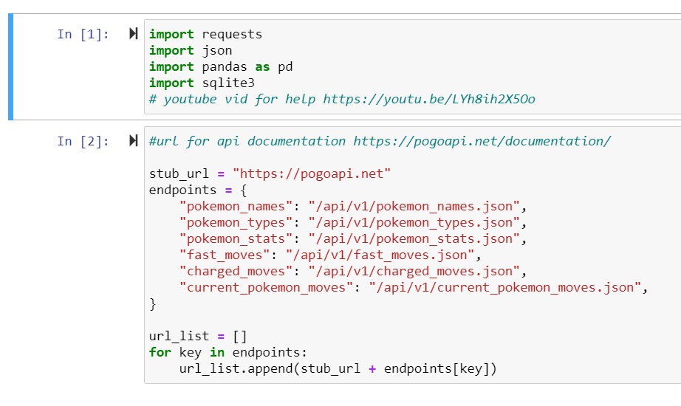
The Extraction
The team extracted relevant Pokémon data through numerous API calls from https://pogoapi.net.

Slide 5
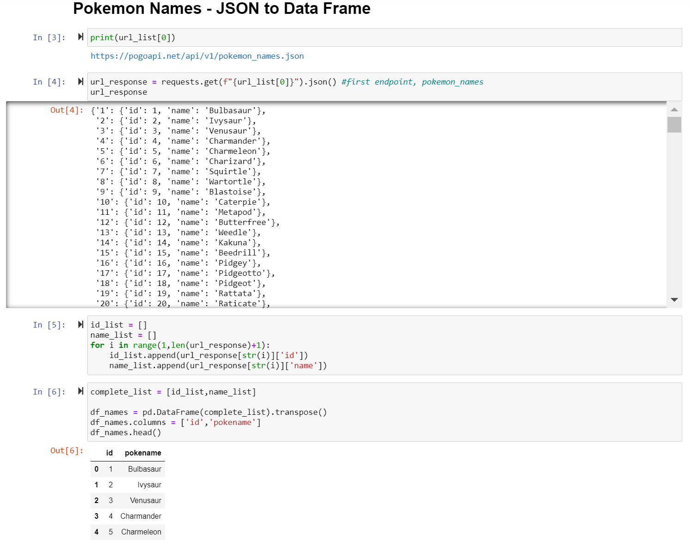
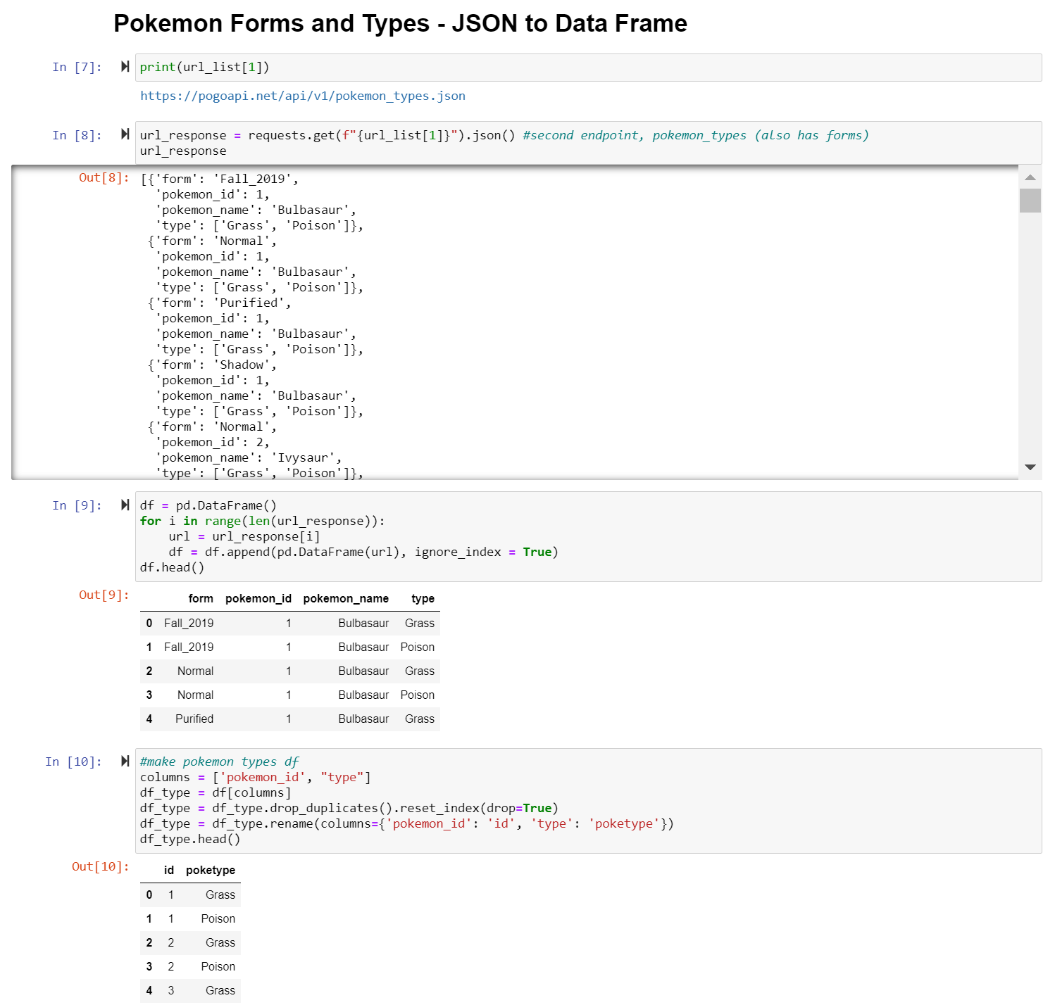


The Transfomation

Slide 6

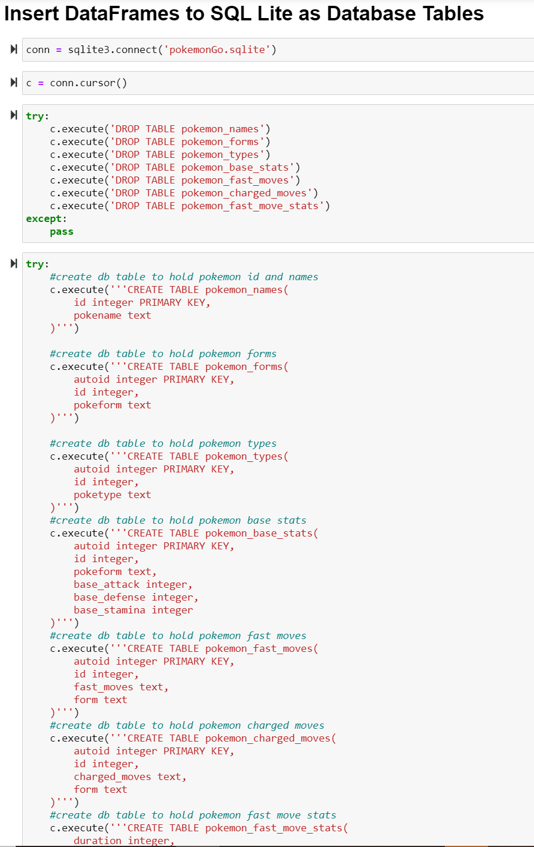

Slide 7


Slide 8
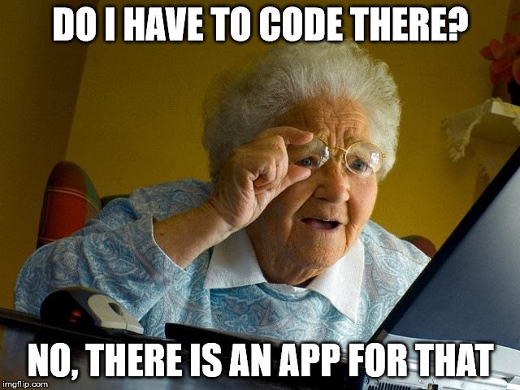
Creating the Full Stack App

Slide 9
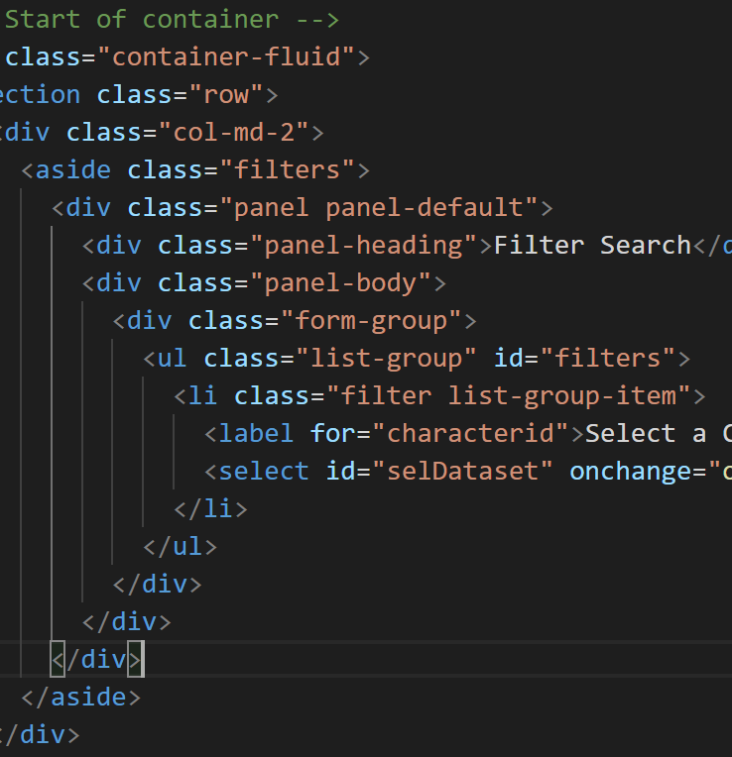
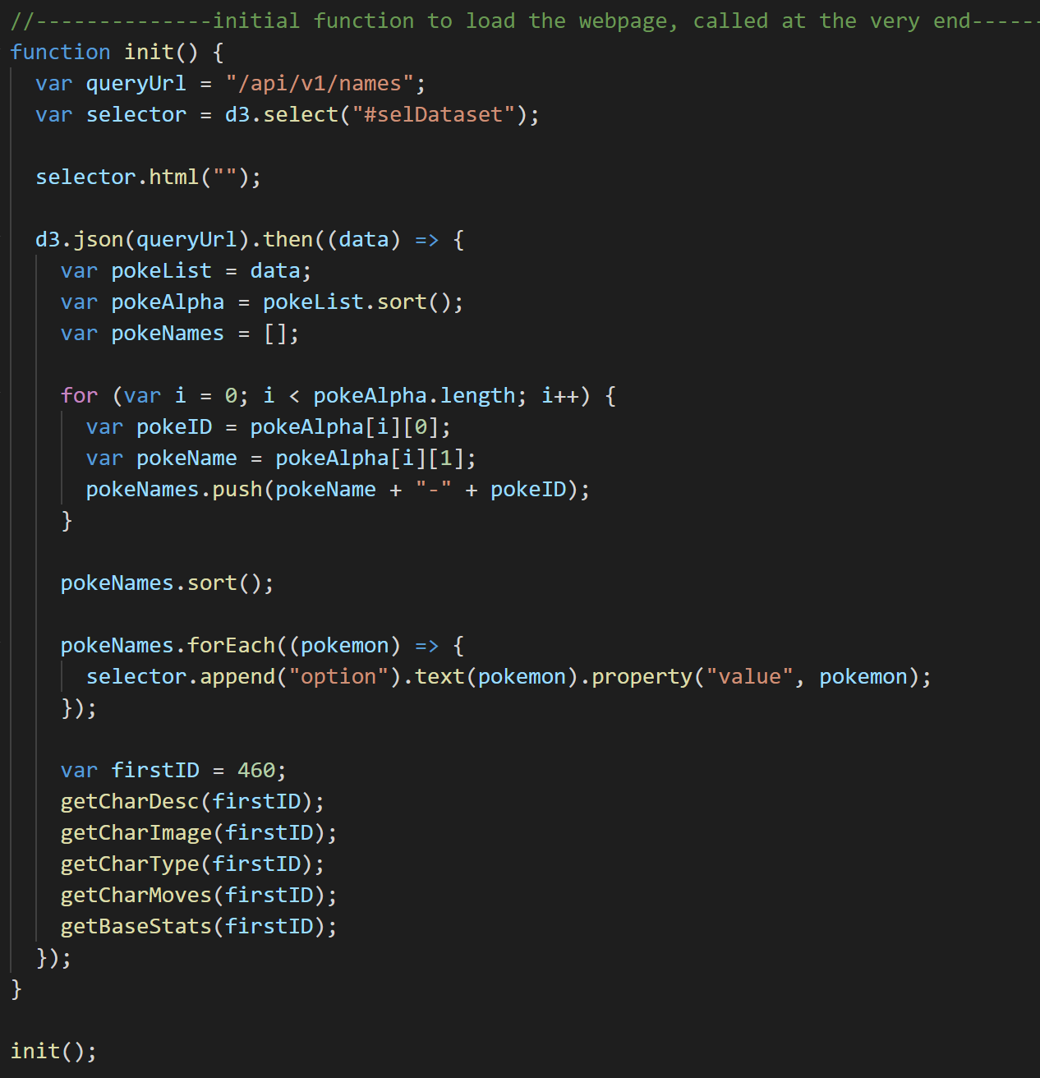
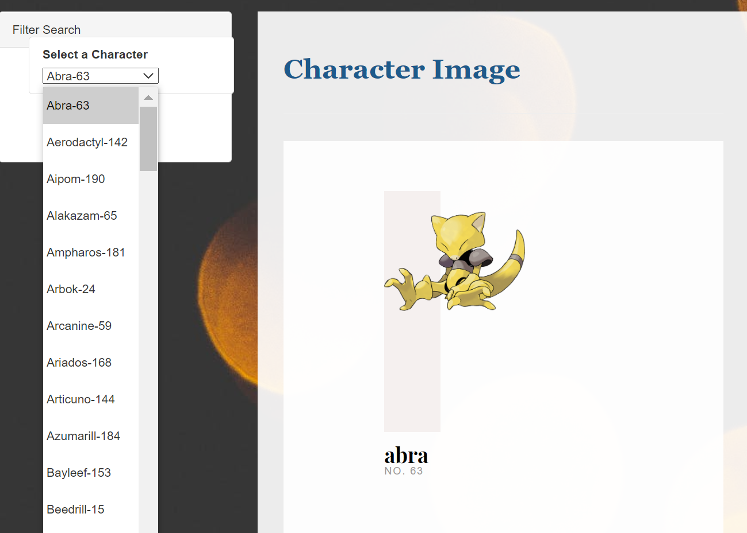
The Dropdown

Slide 10
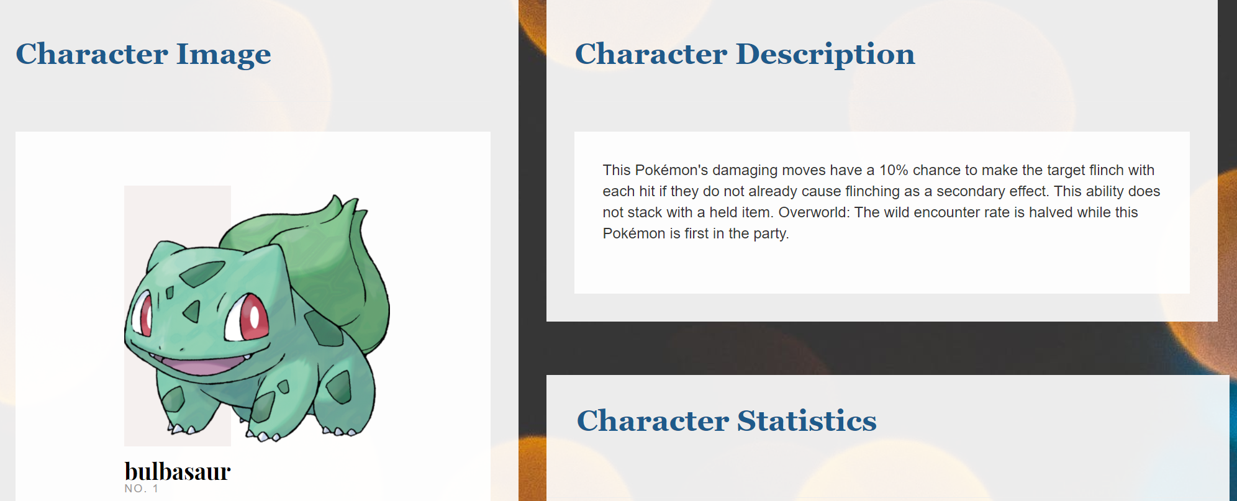
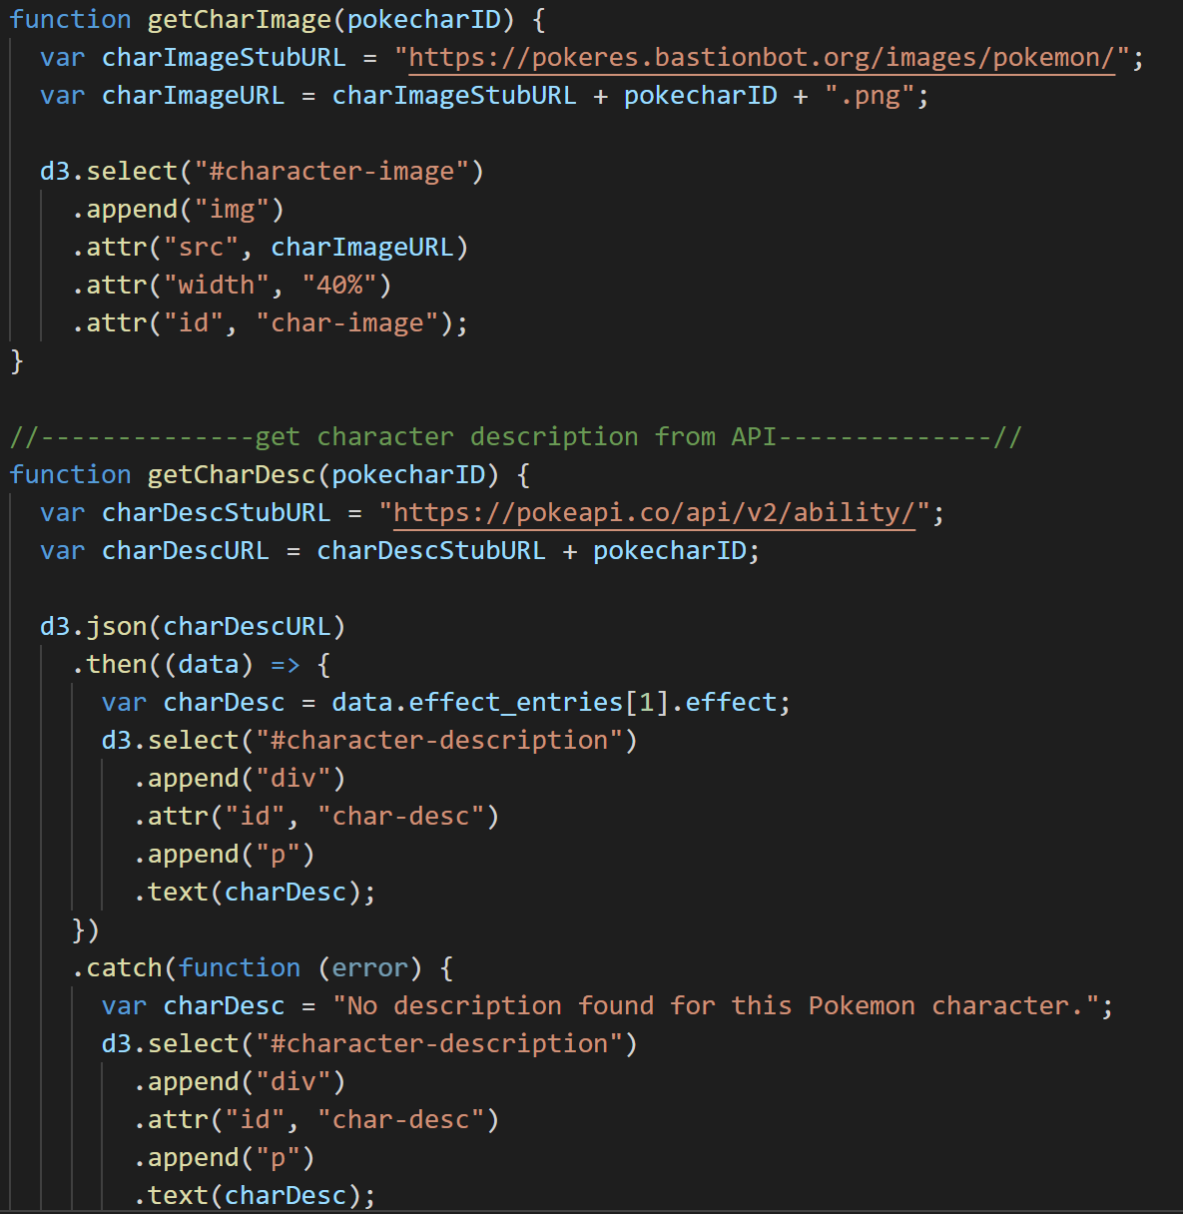
Featured Pokémon
Once the user selects a Pokémon Go character, character-specific information will populate on the screen.

Slide 11
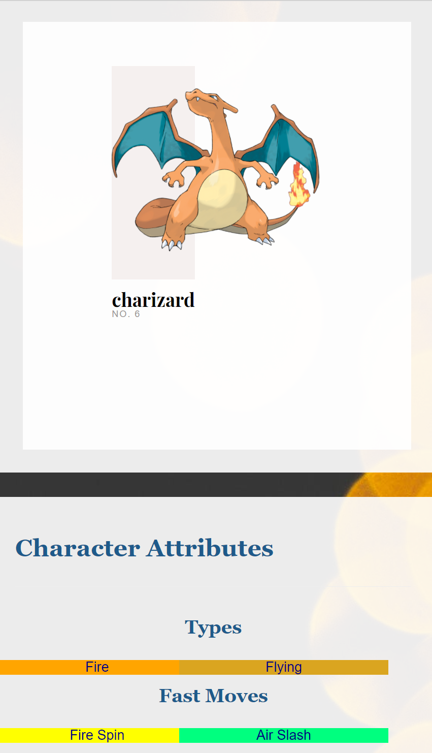
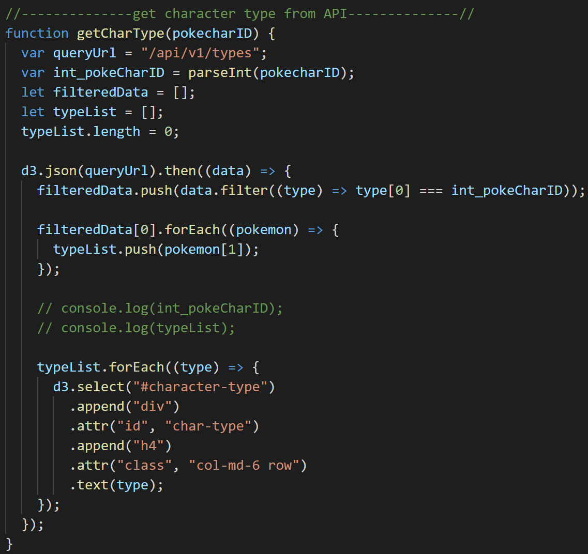
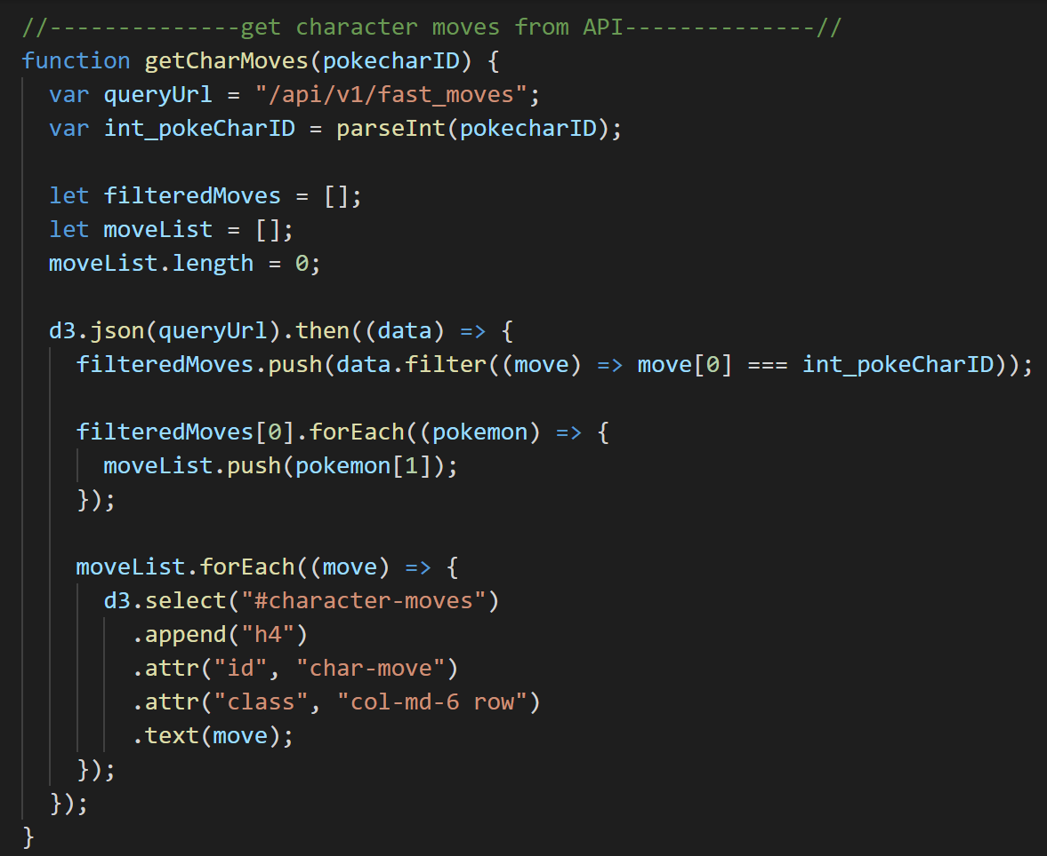

Pokémon Attributes

Slide 12
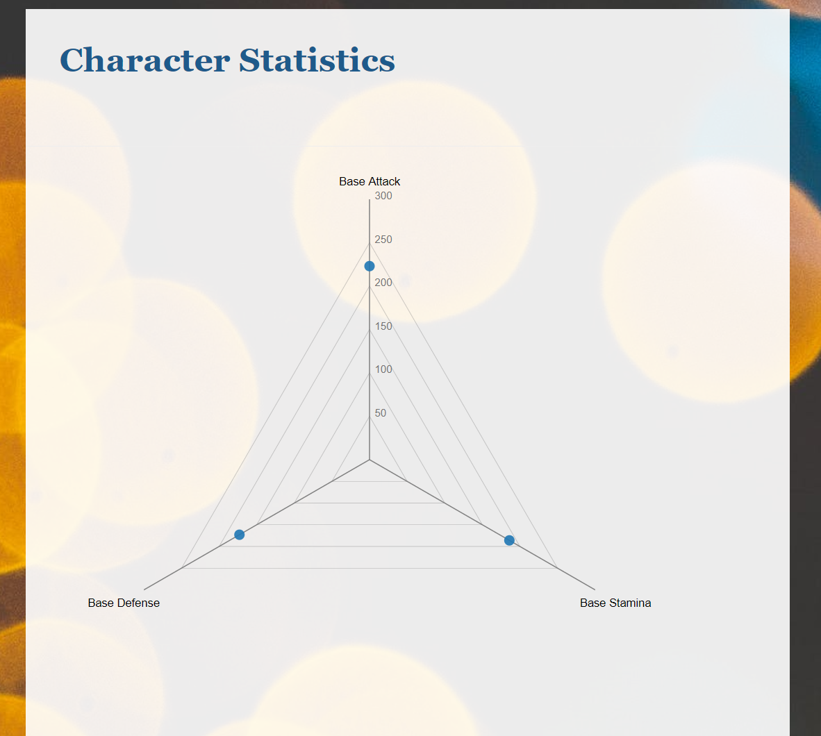
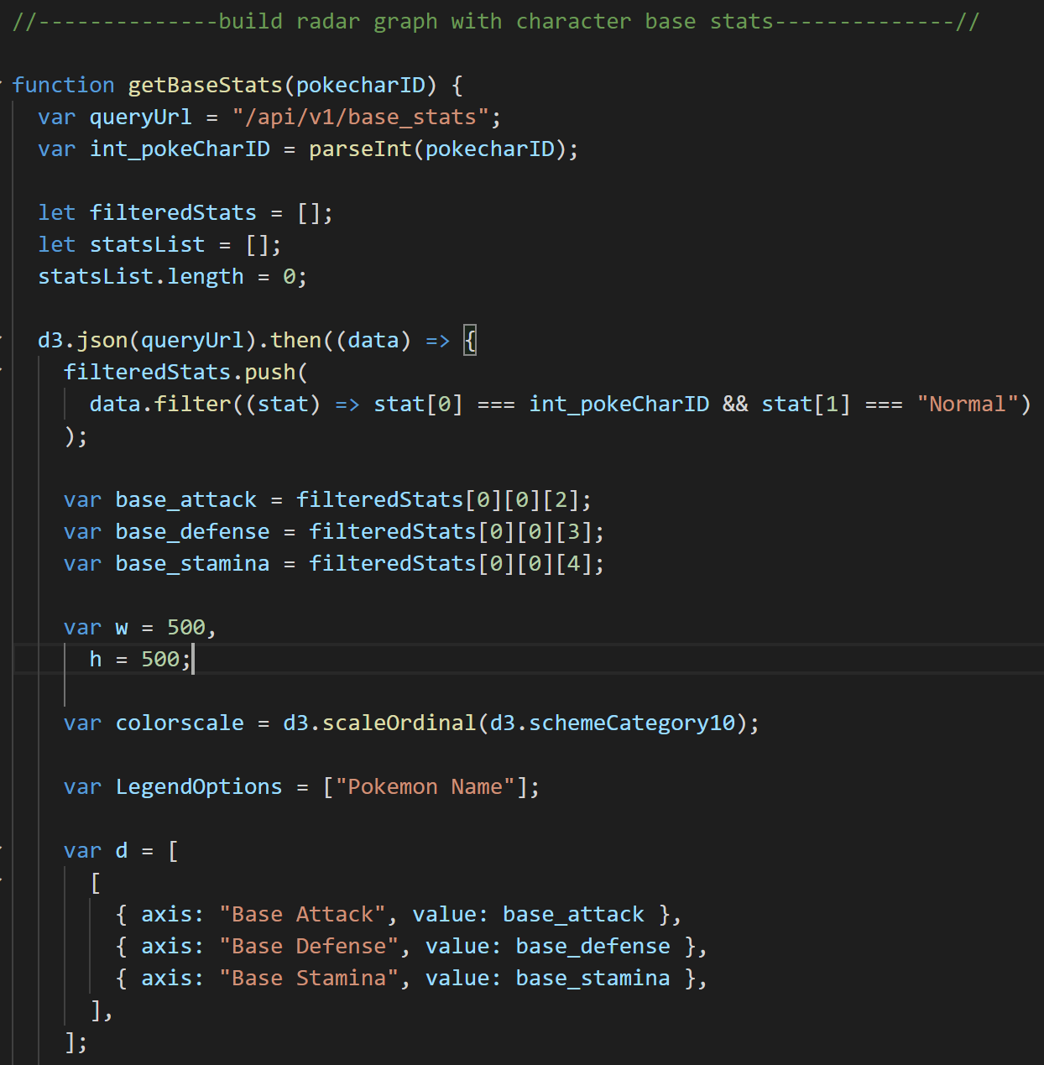
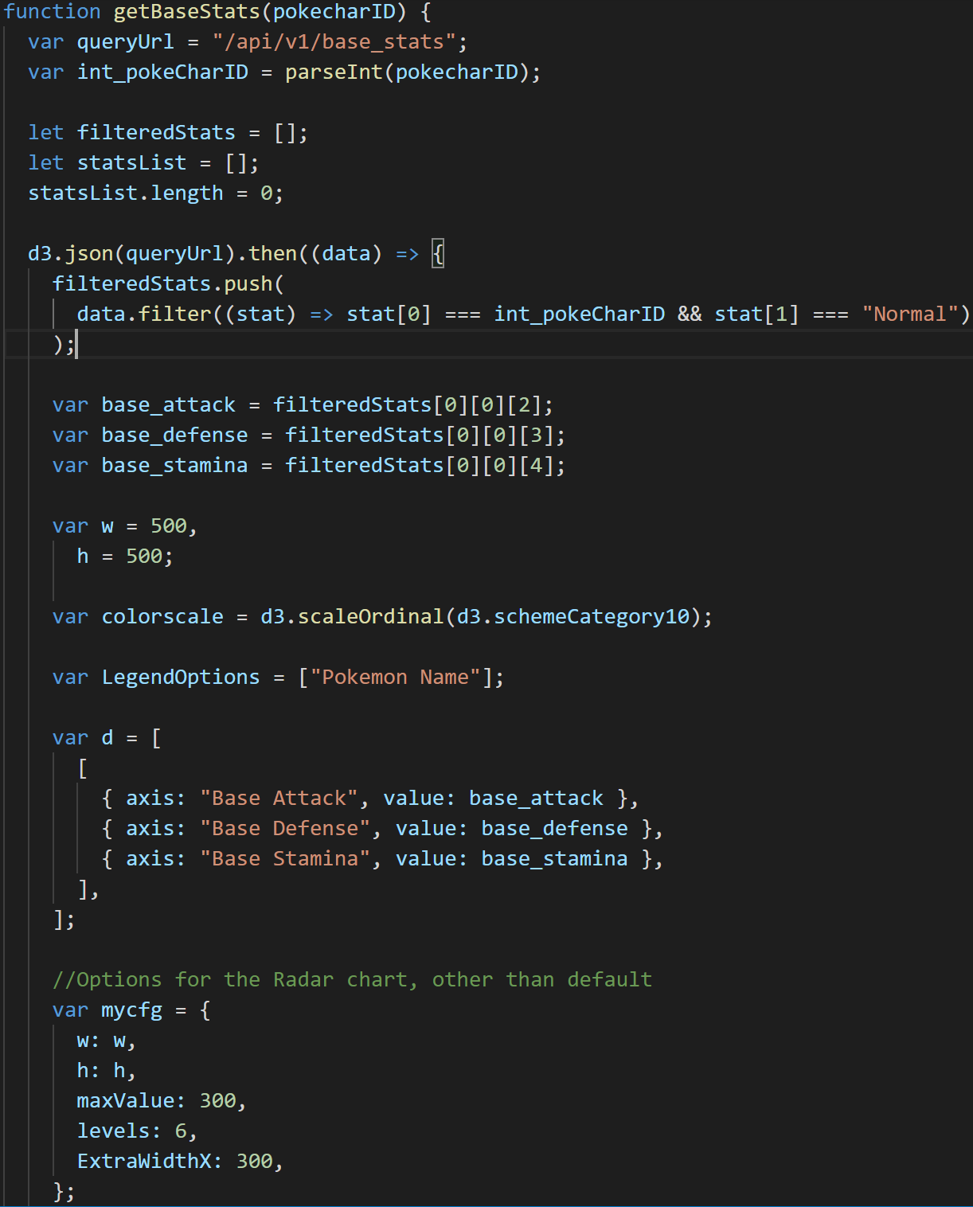
Pokémon Statistics

Slide 13
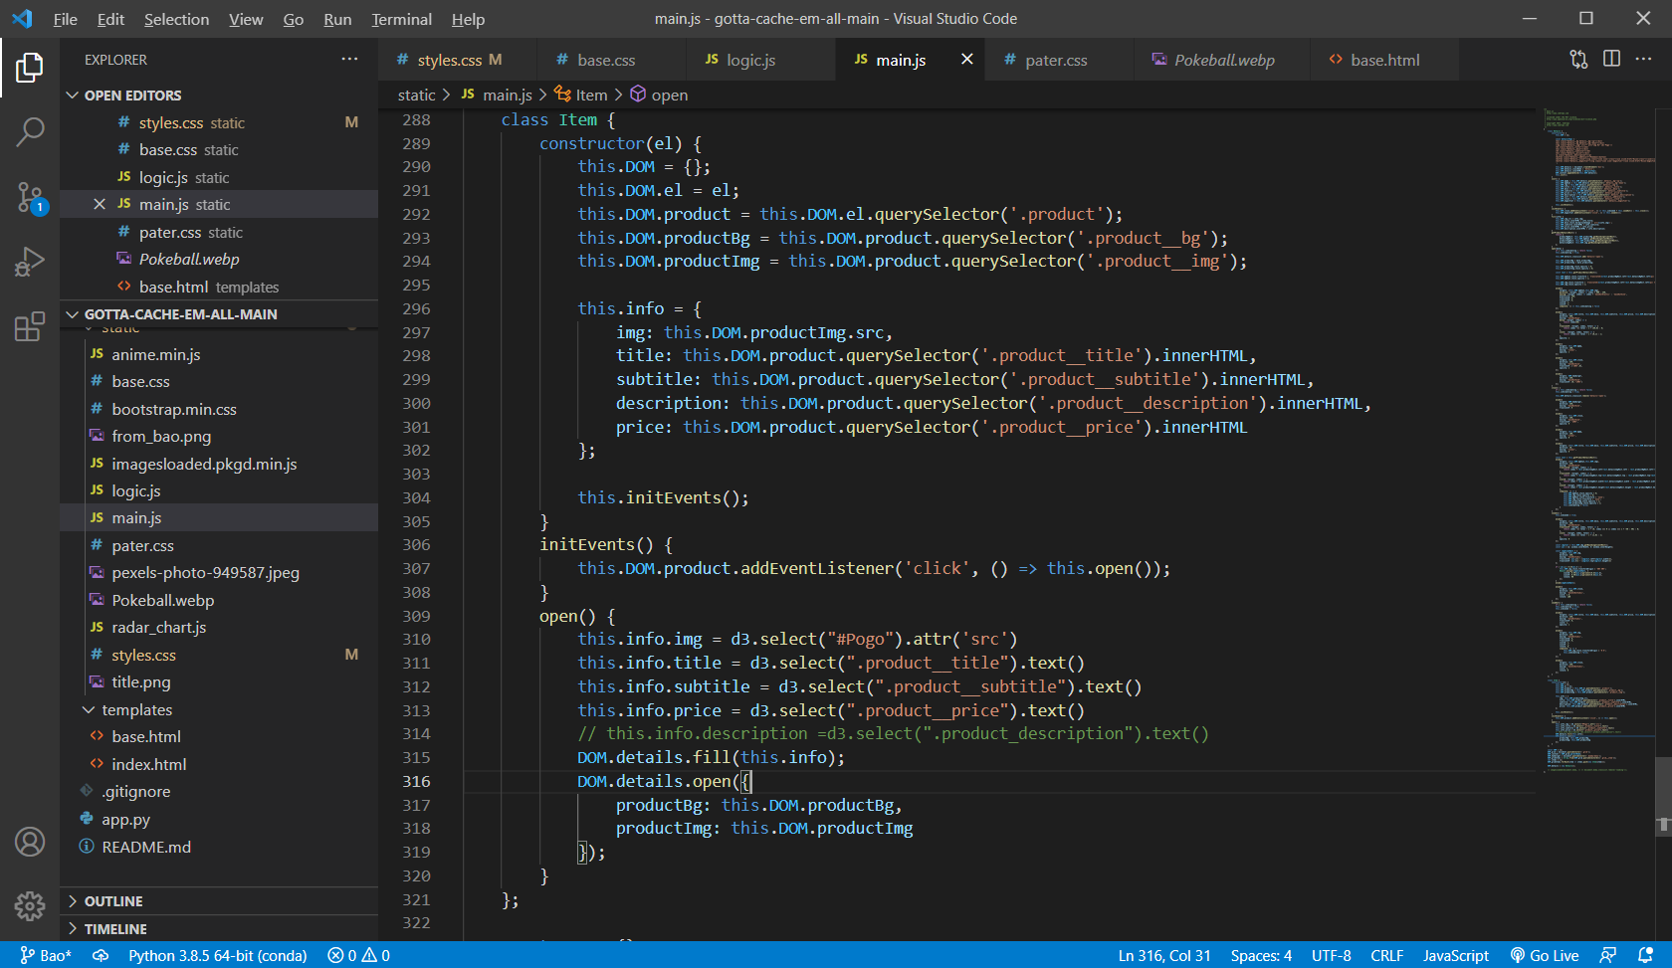
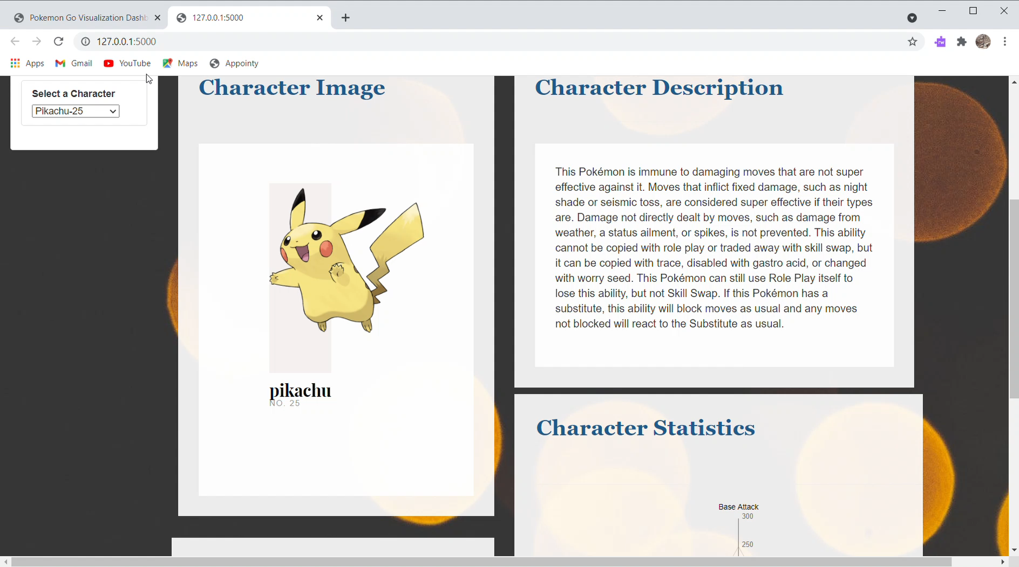
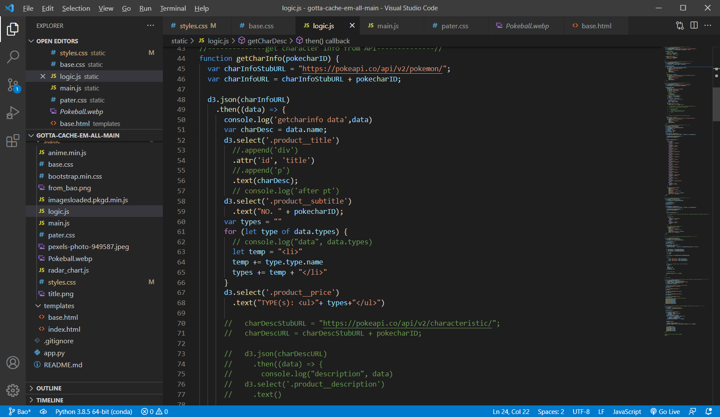
Anime.js

Slide 14
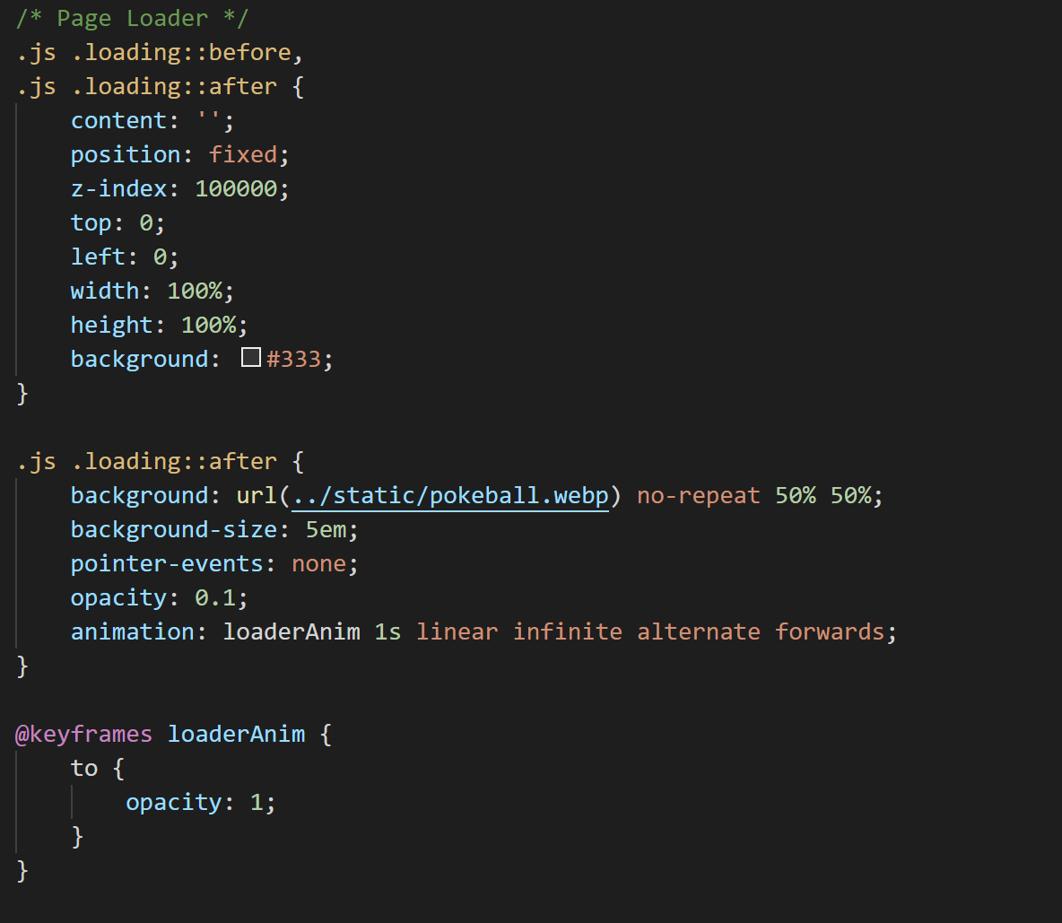



Slide 15
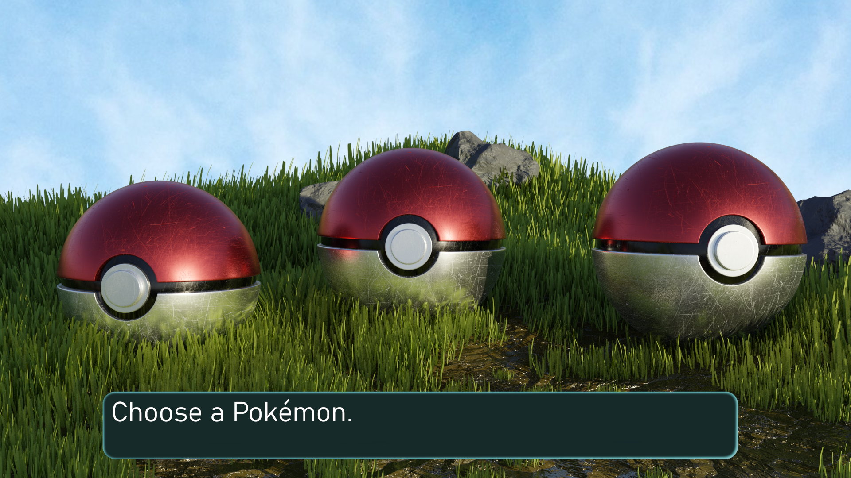
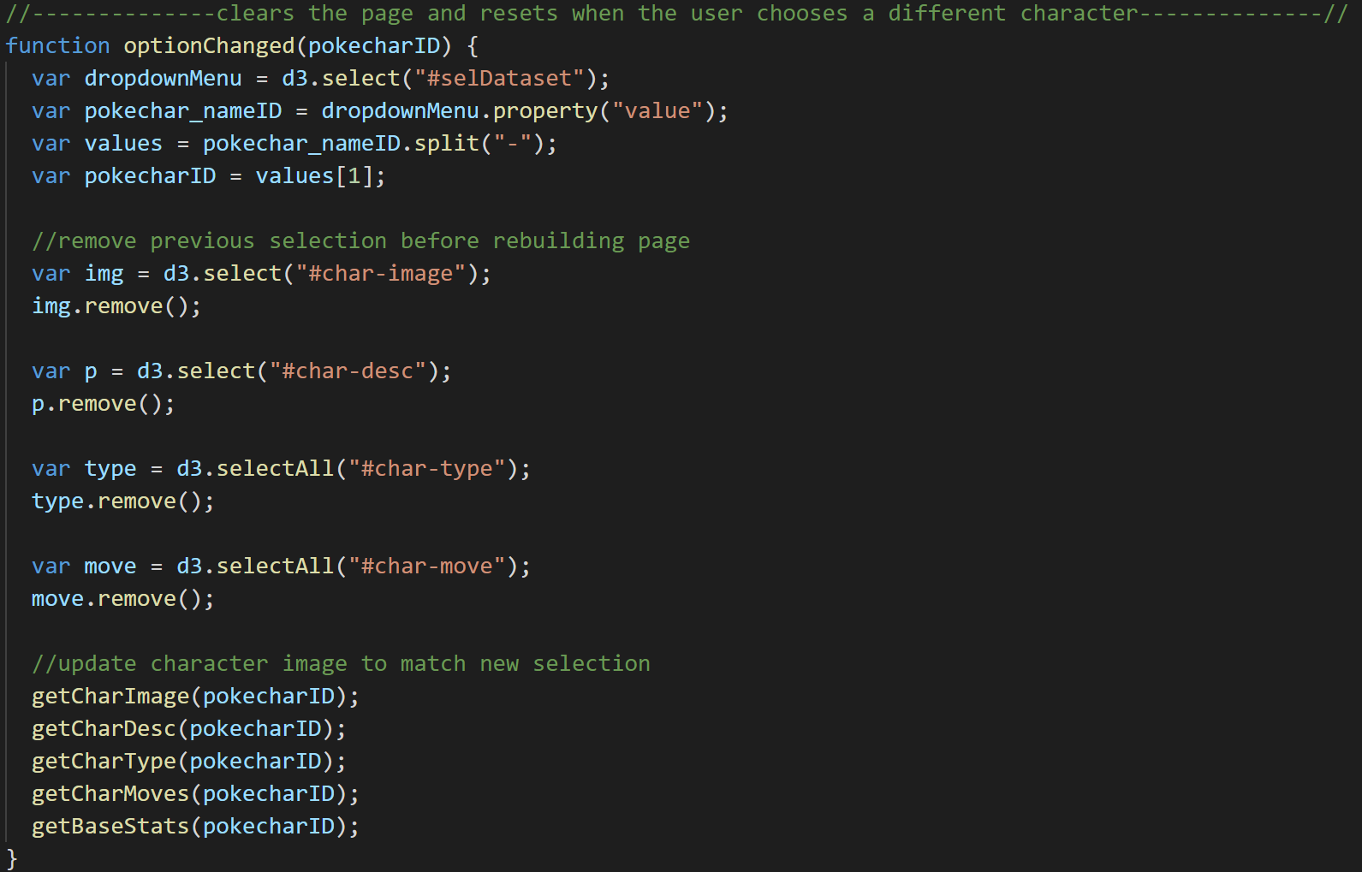

Slide 16

Thank you!

